Slide 1
Building Family Efficacy Linking Family Engagement to Learning Goals and Student Outcomes
Family Engagement Symposium
April 26, 2024

Slide 2
Essential Question: How do we maximize our ability to build relationships with families?
Family: refers to any adult serving in a custodial role in a student’s life; this includes biological and fictive kinships.
Relational Trust- Engaging in cultivating culturally responsive and respectful practices with families. It is based on four elements- respect, competence, integrity, and personal regard.
Notes:
We will review our essential question which is a continuation from our last session

Slide 3
Family Engagement
A full, equal, and equitable partnership among families, educators, and community partners to promote children’s learning and development, from birth through college and career.
(Reynolds and Clements, 2005)
(Mapp, Henderson, Cuevas, Franco, Ewert, 2022)

Slide 4
Linking to Learning
Adding a family engagement component to early childhood programs improves children’s outcomes.
Notes:
Child Parent Centers

Slide 5
Linking to Learning
Collaborating with families through short-term interventions linked to learning can lead to significant gains in reading and math.
(Van Voorhis, 2013)
Notes:
Shared reading, literacy-related conversations, targeted math workshops

Slide 6
Linking to Learning
Partnering with secondary school families improves student achievement, mental health, and graduation rates.
(MacIver, 2015)
(Mapp, Henderson, Cuevas, Franco, Ewert, 2022)
Notes:
School visits Transition to high school collaborate with feeder schools

Slide 7
A Multi-Tiered Approach to Family Engagement (ascd.org)
http:www/ascd.org/el/articles/a multi-tiered approach to family engagement
Notes:
read and discuss

Slide 8
Reflection
What are your specific goals for family engagement this year?
There is a clearly articulated vision for family engagement in your district; does this vision transfer over to the school level?

Slide 9
Reflection Question
If you had parents to come to school that you haven’t seen all year, what would you have them do?

Slide 10
Why Do Families Disengage?
Cycle of Disengagement (Constantino)
Self-Preservation
Isolation
Stress
Anxiety
Fear
Notes:
Dr. Constantino spoke about the cycle of disengagement- Self- preservation, feelings of isolation, stress that we all live under and fear of coming into the school

Slide 11
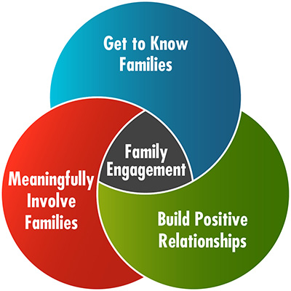
Notes:
I love this graph - Get to Know Families, Be Meaningful- Build Positive Relationships Building Positive relationships by giving families strategies to help their children

Slide 12
Notes:
What resonates with you

Slide 13
Five Simple Principles
Constantino
Principle #1 A Culture That Engages Every Family
Principle #2 Communicate Effectively and Build Relationships
Principle #3 Build Family Efficacy
Principle #4 Engage Every Family in Decision Making
Principle #5 Engage the Greater Community

Slide 14
Four Ways to Build Family Capacity
Reinforce and celebrate families’ awareness of the important role they play and share a two-way communication strategy.
Offer families the opportunities to build skills and confidence. Help them to be an active partner in setting goals and making decisions about their child’s ongoing learning experiences.
Share information that is realistic and presented through a positive lens.
Assure families, especially those who may be unfamiliar with the school culture that they have a powerful voice and share ways that they can use it.
Notes:
Focus Groups/ World Cafes/Surveys short but sweet/ Determine what it is you are trying to measure

Slide 15
What Can Educators Do?
Most Schools are Adept at Engaging the Already Engaged
Family Engagement is NOT About Doing More, but Doing What WE Already Do, Differently
Family Engagement is a PROCESS, not an EVENT
Constantino

Slide 16
All families have aspirational, navigational, social, linguistic, familial,
and resistant capitals
which are interdependent and constantly changing (Yosso, 2005).
Aspirational
Cultural Capital –
Non-financial social assets that promote social mobility beyond economic means.
(values, knowledge, ideas)
Navigational
Familial
Community Cultural Wealth
Resistant
Linguistic
Social
Notes:
We have to honor cultural capital.

Slide 17
Build Family Efficacy
The School makes a conscious effort to educate families on how to play a proactive role in the learning life of their child throughout the child’s career
The school is committed to the academic socialization of families. Develop strategies that encourage and support family engagement in all classroom
Families participate in the development of the student’s learning plan
Allow families to use cultural capital (local knowledge, personal skills, assets, and networks to support school programming.

Slide 18
Core Competencies
Construct learning opportunities with families
Notes:
GOES BACK TO CULTURAL CAPITAL- MANY FAMILIES FEEL THEY DO NOT HAVE THE “SMARTS” TO PROVIDE LEARNING OPPORTUNIITES- YOU HAVE TO FIND OUT WHAT YOUR FAMILIES KNOW

Slide 19
Core Competencies
Link family & community engagement to learning and development
Notes:
THE HOT DOG SOCIALS AND RELATIONSHIP BUILDING IS IMPRTANT BUTG ALWAYS TIE IT BACK TO LEARNING. FAMILY GNGAGEMENT PLAN- DEVELOP YOUR OWN RUBRID AND EVALUATE

Slide 20
Strong Trusting Relationships among families, schools, and communities lay the foundation for all other efforts to succeed
Authentic two-way communication is key to developing trusting relationships and deeper understanding
Family school community partnerships can be transformative at both the personal and institutional level
Meaningful family engagement practice must be systemic and sustained through resources, leadership, support, and infrastructure.
When family engagement is a core value of school systems, it is a powerful equity strategy
Mapp, Henderson, Cuevas, Franco, Ewert

Slide 21
What Can Educators Do?
Three of the Seven Big Ideas
Relationships with Families that are Disengaged Must Lead to Increased Family Efficacy
There is a Direct Correlation Between Underserved Students and Disengaged Families
Without a Process to Build Staff Capacity to Engage and Promote Family Efficacy the Process Cannot be Sustained Over Time
Constantino
Notes:
I know you have been working on your strategic plan

Slide 22
Develop a Family Engagement Action Plan
If you don’t know where you are going….. Any road will get you there, but how will you know when you are there?
-Have you developed actionable & measurable goals for family engagement? Some have family engagement in their school’s goals but do not have a specific action plan for family engagement.

Slide 23
Where Do We Begin?
Evaluate your current status
Formulate goals/strategies
Strategize and link your goals to learning
Action steps/responsibilities
Review your performance
Evaluate your parent engagement plan
Notes:
Evaluate where you are today in relation to your parent engagement efforts, programs & activities. How well are we doing? By getting a sense of where you are today and where you would like to be in the future, will help you to develop a vision for PI
Your goals and strategies should include activities that meet the specific needs of your school and parent community
Establish a year long schedule for how the plan will be accomplished with action steps, timelines and people responsible
At the end of the year it is important to obtain feedback regarding the PI plan both from an internal and external perspective – parents & community
Examine your student achievement results to determine if and how the parent engagement plan positively impacted student achievement
One beginning strategy is conduct a self assessment that would provide information from various needs of your school community

Slide 24
Needs Assessment
https://docs.google.com/document/d/17Hmb_SW5HH_6a9wMKP3pMMhEWRnXlDx0HFNhpqATtr0/edit

Slide 25
Reflection
What kind of information would you like to have concerning the effectiveness of your family engagement policy and processes?
Notes:
Think pair share:
Feedback from participants
Show MCPS Parent Involvement Policy

Slide 26
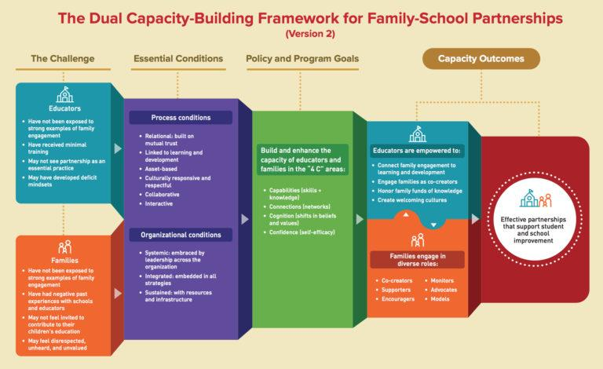
Dual Capacity www.dualcapacity.org 4 C’s Capabilities, Connection, Cognition, Confidence
Notes:
2019 Educators- have not been exposed to strong examples of family engagement
Have receive minimal training
May not see partnerships as an essential practice
May have deficit mindsets
GREEN- Build and enhance capacity of educators
Capabilities- skills and knowledge
Connections (networks0
Cognitions (shifts in beliefs)
Confidence (self-efficacy)

Slide 27
Purpose of Data Collection
Pre and post-assessments are used to understand the impact of family engagement efforts
Helps to measure changes in family and community over time
By comparing data collected before and after an intervention, programs can assess effectiveness and identify areas for improvement.

Slide 28
Data Carousel
The overarching question(s) you identify in the first phase shape these decisions.
Select or collect data that can lead to rich conversations about improvement, not just summarize services provided.
Consider including both quantitative and qualitative data. Quantitative data can identify what happened, and qualitative data can shed light on why.
Recognize the sharing of personal experiences as knowledge and expertise in making sense of data and identifying potential solutions. When gathered systematically, this is qualitative data
(Data Inquiry From Equitable Collaboration)

Slide 29
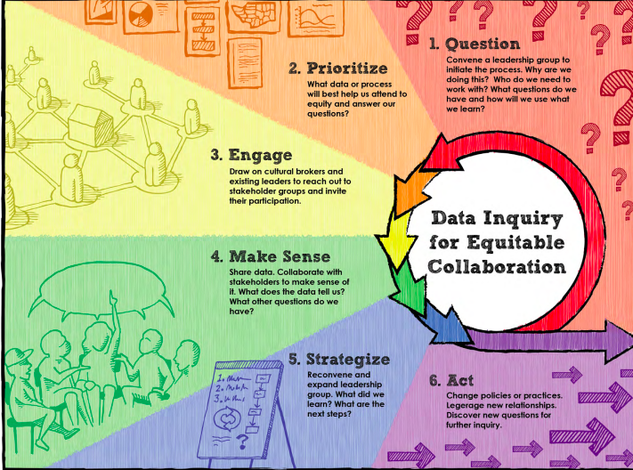

Slide 30
Link To Learning
Does the staff at your school recognize the importance of data-driven family engagement?

Slide 31
School-wide Family Engagement Rubric Flamboyan Foundation

Slide 32
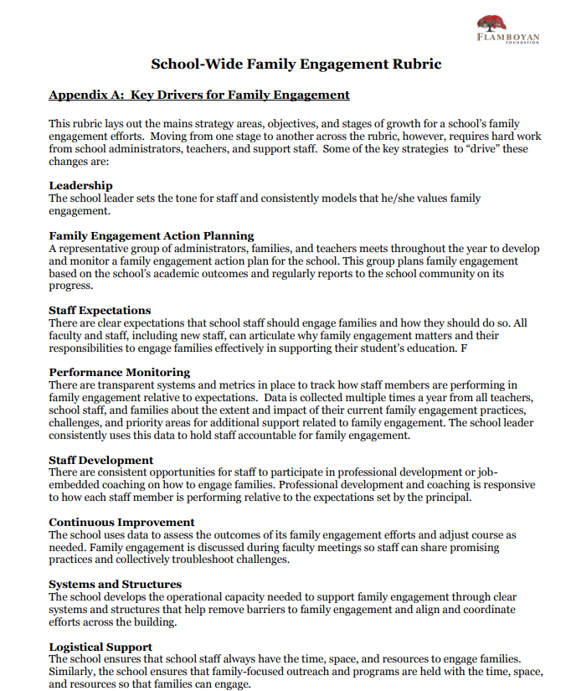
Notes:
Many times when we ask for partnerships in the community, we do not have a plan. We just say we want community partnerships. Before any requests for partnerships we need to strategically plan

Slide 33
Family Engagement Communication Rubric
Communication | Emerging | Progressing | Excelling
Each team will ensure that communication with parents/family is in the form of two-way communication. Each team provides all written communication and conducts meetings in language that is understandable le for all families. | __ Information is sent to parent/families. __ Written communication and translation services are inconsistent. | __ Two-way communication with parents/families is inconsistent. __ Written communication is translated but meetings are conducted with translator on an inconsistent basis. | __ All communication is documented with parent/family responses. __ All written communication is translated and all meetings are conducted with translator (parent liaison or parent volunteer).

Slide 34
Indicators | Initiating | Progressing | Excelling | Current Status
Linking student work to learning standards which leads to college and career readiness for all students | Student work is displayed throughout the school in a way that shows how academic and vocational standards are being met. | Student work is displayed in the school in a way that shows how academic and vocational standards are being met. The school explains to families what good work looks like under learning standards and what students are learning in the classroom throughout the year. | Families, schools, and community collaborate to align school events and community resources to learning standards and ensure that families and students understand | Level 1: Initiating Level 2: Progressing Level 3: Excelling
Using standardized test results to increase student achievement | The school and district recognize the importance of analyzing student performance data and identify achievement gaps amongst and between groups of students. The school informs families, in a language they understand, about the results of standardized tests and how their children performed on the tests. | Schools and districts analyze data with all constituents. Information is disseminated on how to interpret test data And how to help their child based on performance scores. | Families, school personnel, and community representatives participate in academic and curriculum committees to discuss how to raise expectations and achievement for every student in academic and vocational paths | Level 1: Initiating Level 2: Progressing Level 3: Excelling
Notes:
FINISH

Slide 35
Boston Public Schools- Schoolwide Learning Link
Target a specific grade level or group of students;
Focus on the mastery of a specific task;
Provide a specific role for families to play in the mastery of that task; and
Involve two-way communication between home and school around task mastery.

Slide 36
Partners in Education: A Dual Capacity-Building Framework for Family–School Partnerships - From Southwest Educational Development Laboratory, this paper presents a framework, based in existing research and best practices, for designing family engagement initiatives that build capacity among educators and families to partner with one another around student success.
Family Engagement Framework: A Tool for California School Districts - From the California Department of Education and WestEd, a tool for leaders in school districts and county offices of education to use as they work with schools, families, and communities to plan, implement, and evaluate family engagement practices that directly impact improved student achievement.
How Family, School, and Community Engagement Can Improve Student Achievement and Influence School Reform - From the Nellie Mae Education Foundation. A literature review to assist in the goal of understanding how family and community partnerships can promote school improvement efforts.

Slide 37
Discussion
Notes:
Share one of your strategies and how are you going to link it to learning

Slide 39
Reflection
Moving parent involvement forward in your school, what type of information would you need from your parents/stakeholders?

Slide 40
Final Reflection
Which students/families could benefit most from a family outreach plan?
How do you plan to link family engagement to learning goals?

Slide 41
Final Thoughts
What resonated with you?
Notes:
implicit explicit bias

Slide 42
Where do we go from here?

Slide 43
rmoffitt@si4all.com

Slide 44
Build trust through close, equitable conversations between parents and teachers improves student achievement

Slide 45
Thoughts/Reflections
What resonates with you?
One thing you want to know more about?
Notes:
implicit explicit bias

